Slide 1
Storage for the DBA
Denny Cherry
mrdenny@mrdenny.com
MVP, MCSA, MCDBA, MCTS, MCITP

Slide 2
Agenda
Storage Terminology
Array Cache Setup
RAID Types
Tiered Storage
Disk Alignment
Spindle Types
Physical Array Diagram

Slide 3
Storage Terminology
LUN = Logical Unit Number
Host = The Server or Servers a LUN is presented to
SAN = Storage Area Network
Fabric = Fibre network which makes up the SAN
Array = Box with the Spindles in it

Slide 4
Storage Terminology
Disk = How the OS sees a LUN when presented
Spindle = Physical disks in the Storage Array
IOps = Physical Operation To Disk
Sequential IO = Reads or writes which are sequential on the spindle
Random IO = Reads or writes which are located at random positions on the spindle

Slide 5
Array Cache Setup
OLTP databases make poor use of SAN read cache
OLAP databases make good use of SAN read cache
Try reducing read cache and increasing write cache
OLTP databases with high buffer cache hit ratios may be able to have the read cache disabled
There is no one correct setup. Every system is different.

Slide 6
When Write Cache Gets Full?
Doesn’t flush to disk until low watermark is hit
Force flushes once high watermark is hit
Force flushing completely empties write cache
Force flushing disables write cache until write cache is disabled
If adjustable, set low very low, and high watermark very high (20/90)
If cache gets to 100% full – Pray!

Slide 7
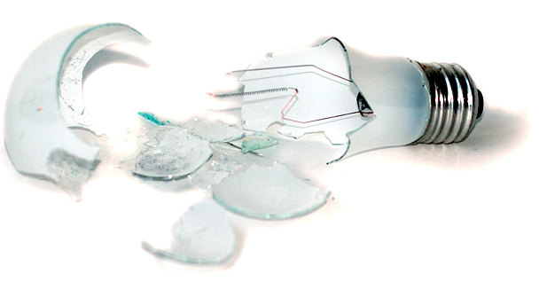
Oh crap the power went out!
Most arrays have internal batteries
Write cache is flushed to disk
After flush array powers down
On power-up flushed cached is read and committed to LUNs before LUN is made available
Make sure SQL is down before the array flushes
http://www.flickr.com/photos/robertfrancis/352039299/

Slide 8
RAID Types
RAID 0
Straight Stripe
No redundancy
Very fast
Low cost
Any disk failure looses data
Can not survive no disks failures
Requires 2 or more disks

Slide 9
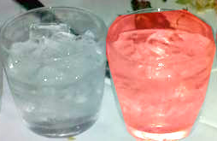
RAID Types
RAID 1
Full Mirror of data
No performance Benefit
High Cost
Requires 2 disks
Can survive 1 disk failure

Slide 10
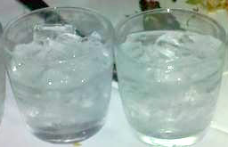
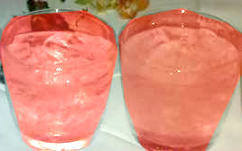
RAID Types
RAID 0+1
Drives Striped, then Stripes Mirrored
High Cost
High Performance
Requires 2 disks
Requires an even number of disks
Can survive 1 spindle failure
May survive multiple spindle failure

Slide 11
RAID Types
RAID 10 (aka 1+0)
Drives Mirrored, then Mirrors Striped
High Cost
High Performance
Requires 2 disks
Requires an even number of disks
Can survive 1 spindle failure
May survive multiple spindle failure

Slide 12
RAID Types
RAID 5
Stripe with single parity drive
Low cost
Good performance
Write penalty
Can survive a single drive failure
Requires at least 3 disks

Slide 13
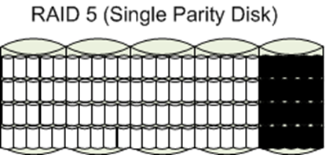
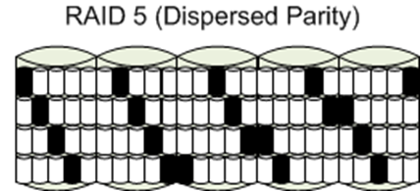
Not all RAID 5 is Created Equal
RAID 6 can be done this way as well.

Slide 14
RAID Types
RAID 6
Stripe with two parity drives
Slightly higher cost per gig than RAID 5, good performance
Same write penalty as RAID 5
Can survive 2 disk failures
Requires at least 4 disks

Slide 15
Disk Alignment
Can improve SQL disk performance up to 100%
(64 1k blocks/64k IO)=100% of IO is impacted
Must be done before data is put on the disk
Windows 2000 - Diskpar
Windows 2003 - Diskpart
Windows 2008 - Automatic

Slide 16
Disk Alignment

Slide 17
Tiered Storage
Time is Money
http://www.flickr.com/photos/21560098@N06/3832712784/

Slide 18
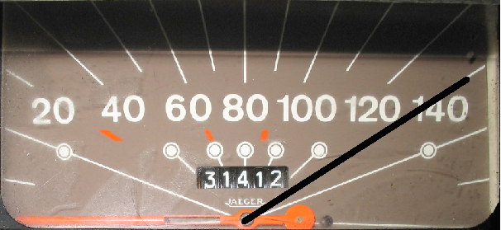
Tiered Storage
Tier 0
Enterprise Flash Disks low capacity drives
Very high cost
Very high speed storage
Great for Databases
http://commons.wikimedia.org/wiki/File:Speedometer_Odometer.jpg

Slide 19
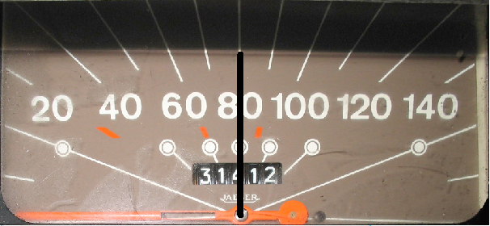
Tiered Storage
Tier 1
15k RPM Fibre Channel low capacity drives
High cost, high speed storage
Great for Databases, Exchange, Virtual Machines
http://commons.wikimedia.org/wiki/File:Speedometer_Odometer.jpg

Slide 20
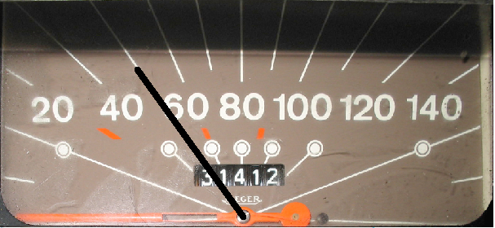
Tiered Storage
Tier 2
10k RPM Fibre Channel medium capacity drives
Medium cost, medium speed storage
Great for File Servers, Database Archives, Exchange
http://commons.wikimedia.org/wiki/File:Speedometer_Odometer.jpg

Slide 21
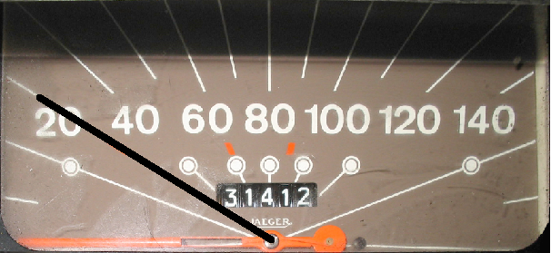
Tiered Storage
Tier 3
7.2/5.4k RPM SATA/SAS high capacity drives
Low cost, low speed storage
Great for Backups, Archives, Exchange
http://commons.wikimedia.org/wiki/File:Speedometer_Odometer.jpg

Slide 22
Spindle Types
Fibre Channel (FC)
Fastest Bus Speeds between 2-4 Gigs
SCSI
Older Technology, slower bus speeds
SATA
Newer Technology, even slower bus speeds
Enterprise Flash Disks (EFDs)
Newest Technology, same bus speeds as FC

Slide 23
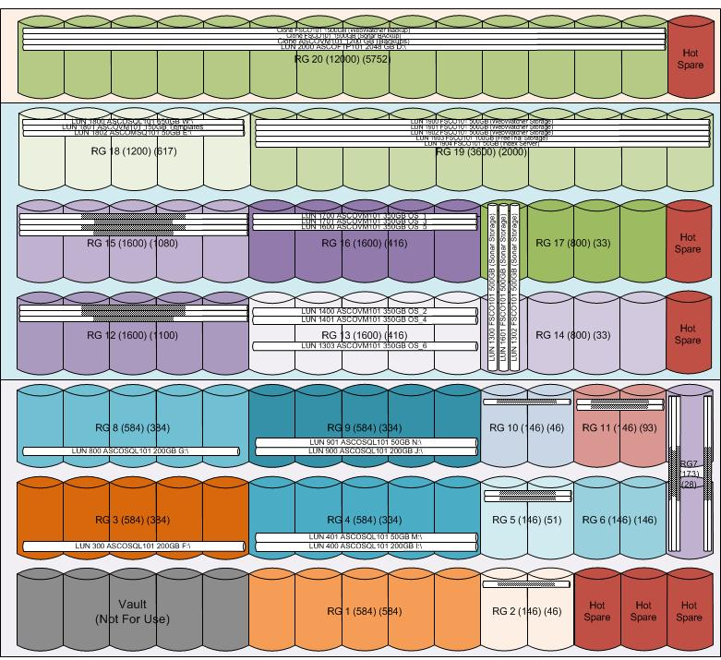
Array Diagram

Slide 24
Denny Cherry
mrdenny@mrdenny.com
http://itke.techtarget.com/sql-server

